Slide 1
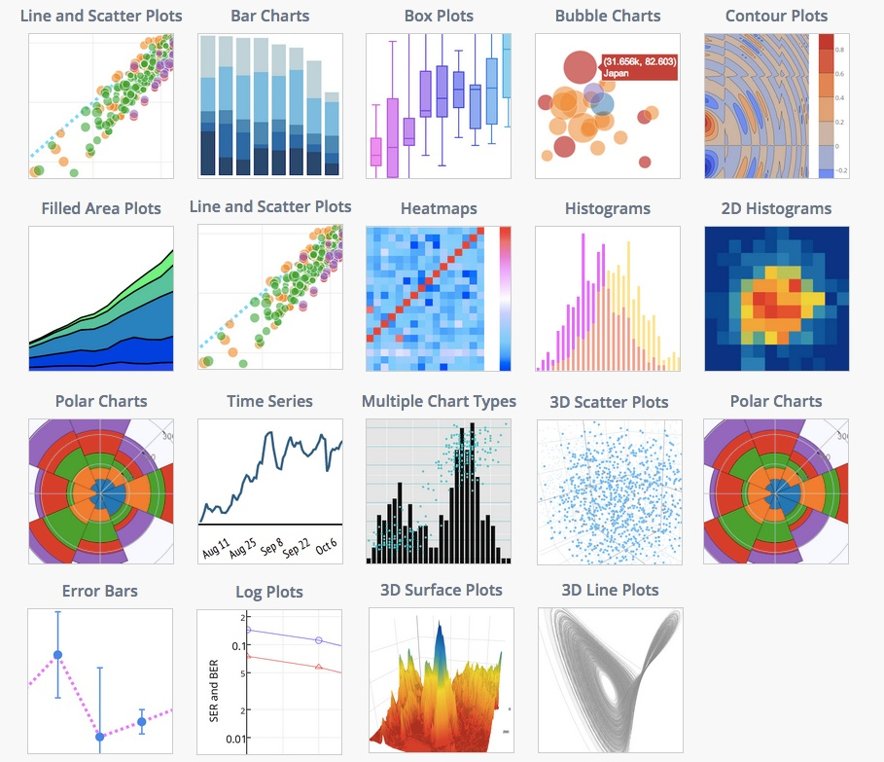




INTERACTIVE DATA VISUALIZATION
Jupyter Notebook
Data represented in a visual format that helps people to extract meaning from that data much more quickly and easily.
Plotly interactive controls:
Buttons
Dropdowns
Slider
Qgrid
An interactive grid for sorting, filtering, and editing DataFrames .
Analyze and visualize data together…
Shiela Jimenez
Data Science Enthusiast

Slide 2
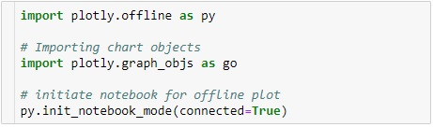
Plotly
Interactive controls (button, dropdown and slider)
Plotly is an online analytics and visualization libraries for JavaScript, python, R etc. The core library is written on top of D3 so the charts are interactive
Installation :
Module imports:
Offline plotly: Allows you to create graphs offline.
Demo:
pip install plotly or
pip install plotly -- upgrade

Slide 3
Qgrid
Interactive grid widget for exploring DataFrames in Jupiter Notebook.
Qgrid allows you to sort, filter, and edit the contents of your DataFrames
using an intuitive point-and-click interface.
Installation :
API Documentation
Demo:
with pip
pip install qgrid
jupyter nbextension enable --py --sy-prefix qgrid
with conda
conda install -qgrid
API documentation is hosted on:
https://qgrid.readthedocs.io

